Slide 1

JAVALINGO
an Engineers&Co. product

Slide 2
JAVALINGO
Java is one of the most used and most requested languages in the world.
More and more young programmers are starting to program using Java.
But what is one of Java's big problems?

Slide 3
JAVALINGO: WHY DOES IT EXIST?
THE DOCUMENTATION
Is one of the biggest problem in java
Java's documentation is extremely complicated for a novice programmer to use.
Often this leads people who are new to this world to give up the idea of programming.

Slide 4

JAVALINGO: HOW WE SOLVE IT?
JavaLingo is an app that allows you to learn to program in Java in a simple and effective way.
Our solution is combining fun games and knowledge about the programing language and the ways it works

Slide 5
JAVALINGO: HOW WE SOLVE IT?
The biggest advantage we have over other platforms that try to teach programming is that we are doing it with games instead of documentation and problems you have to solve. Our mission is to bring a new way for programmers to improve themselves without dry, long, and empty documentation.

Slide 6

JAVALINGO: OUR TEAM
Front-end team:
Ana Gil Orozco: Team leader and developer
Alvaro Martin Ramirez: Developer
Leandro Martin Calvo: Developer
Rubén Ipiña Rivas: Developer
Back-end team:
Roberto Garcia Roman: Team leader and developer
Matteo Buccolieri: Developer
Andrei Mihailescu: Developer
Elena Raluca Mitran: Developer

Slide 7

JAVALINGO: IMPLEMENTATIONS
COMMITMENTS:
the main app in itself
the user log-in option
the games/test that you have to solve
the score that you get if you solve problems correctly
the forum where you can ask questions
the daily challenge
EXTENSIONS:
a nice interface
ranking
the ability to customize the profile
EXCLUSION:
the notification you get
the time it takes you to solve a quiz/test
shop for an avatar (the money is the points you make when you solve a quiz/test)
Implemented
Not implemented

Slide 8
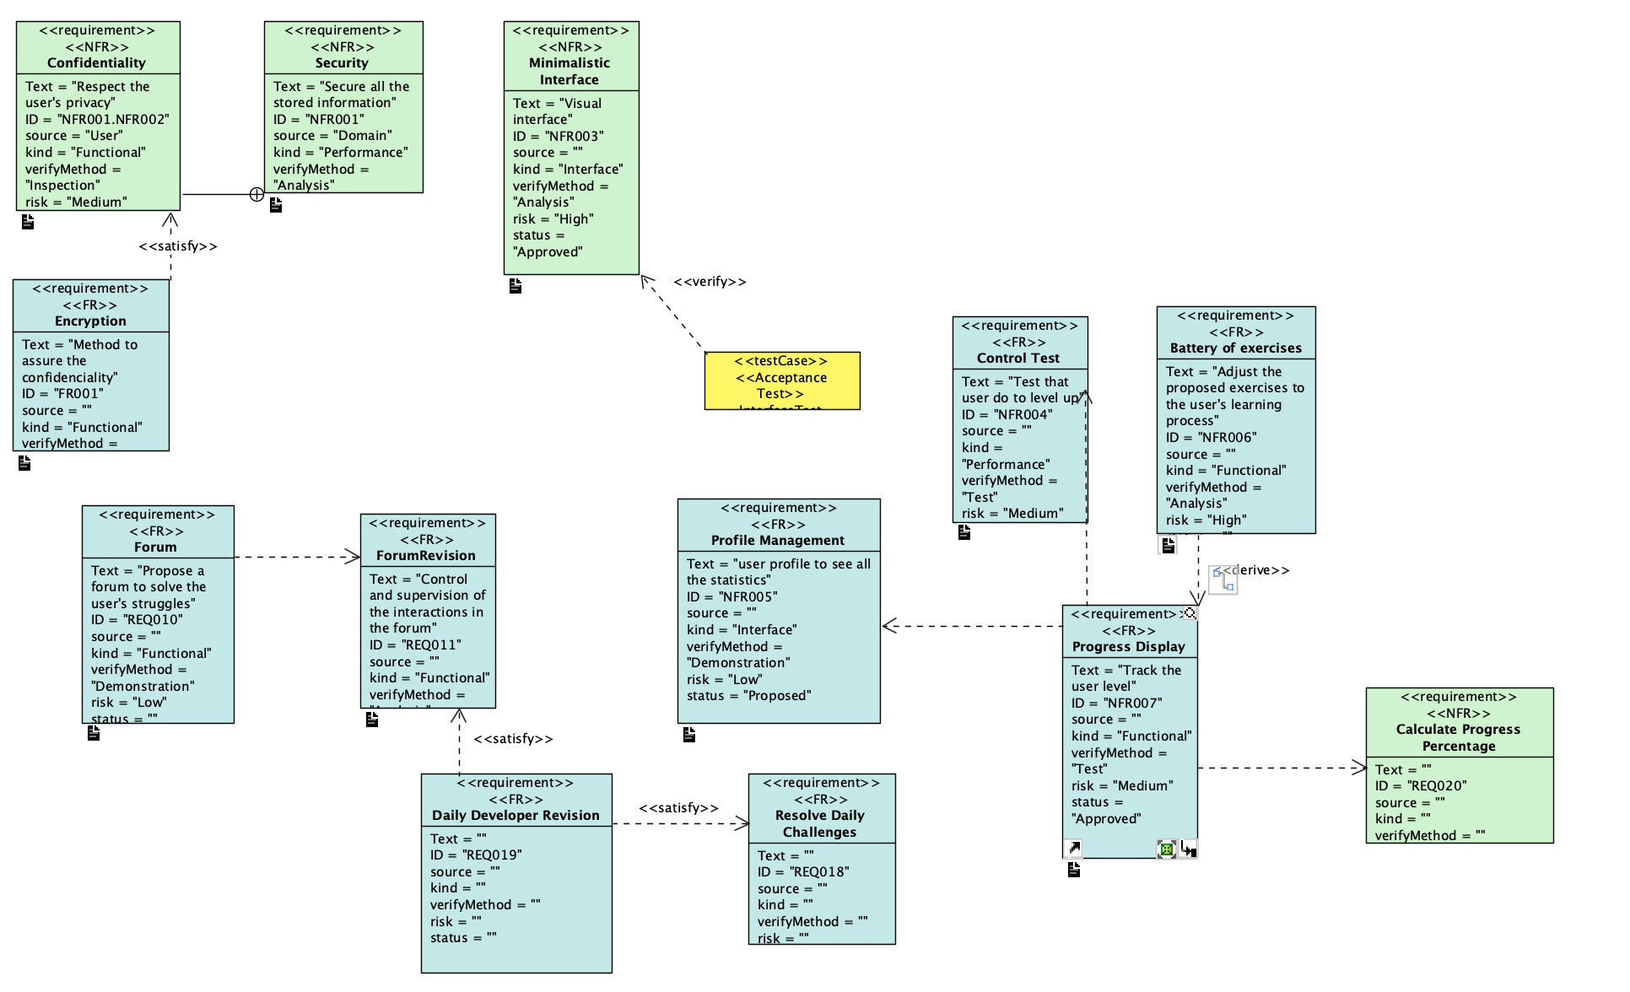
SW engineering activities: Requirements

Slide 9
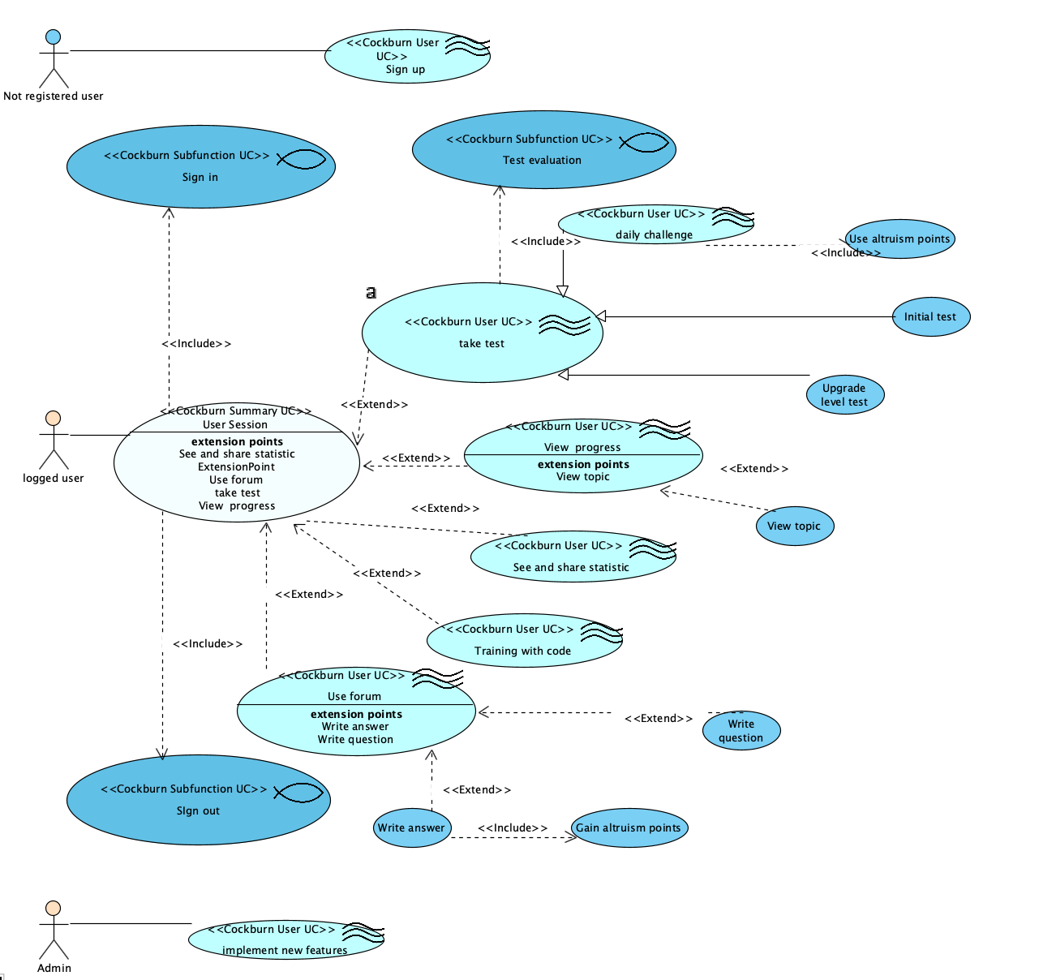
SW engineering activities: Use cases model

Slide 10
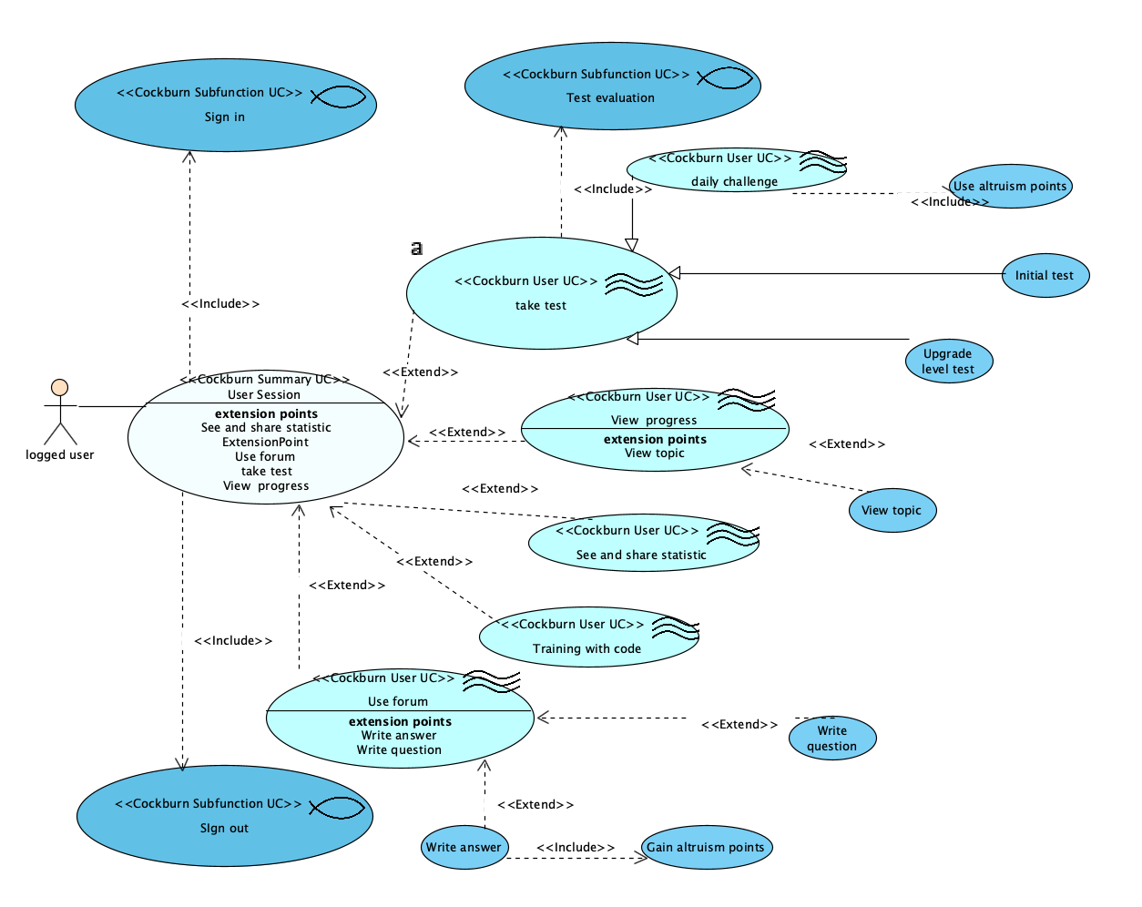
SW engineering activities: Use cases model

Slide 11
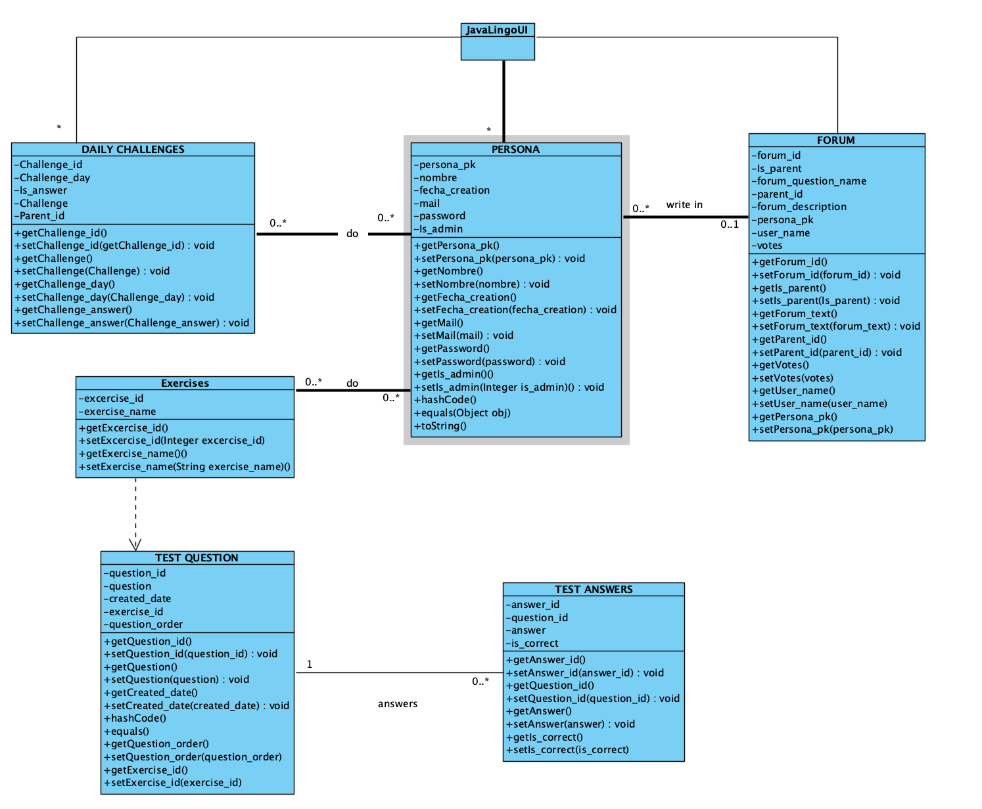
SW engineering activities: Class model

Slide 12
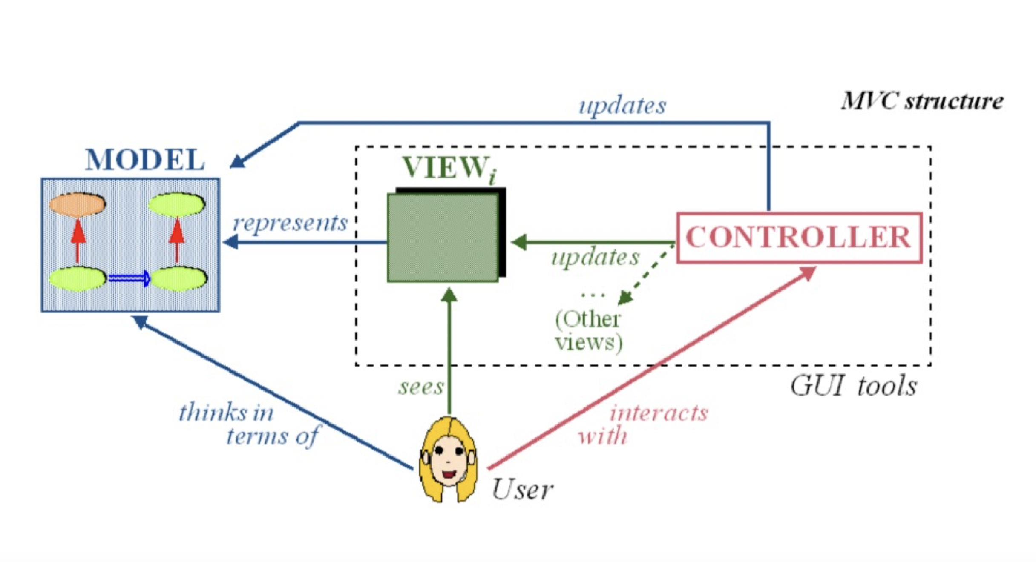
SW engineering activities: Architecture

Slide 13
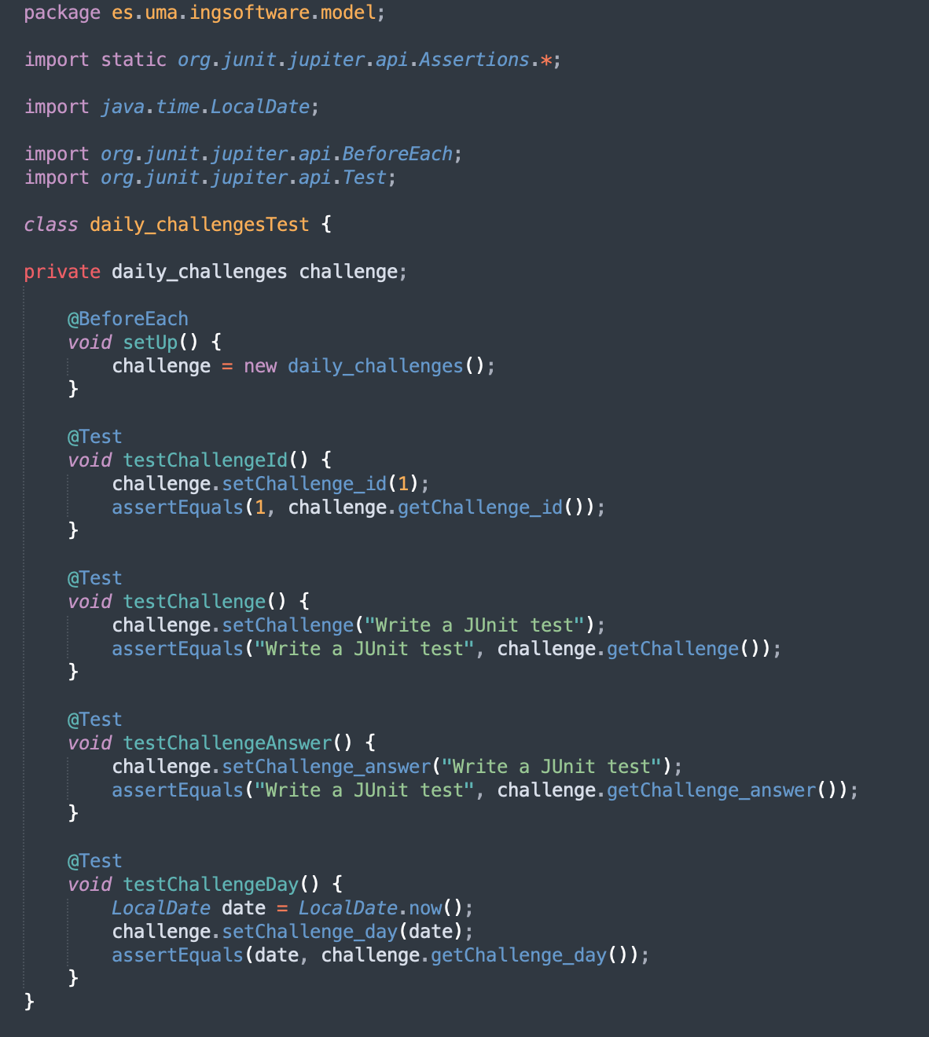
SW engineering activities: Testing
To test JavaLingo we used Junit, a unit testing framework.
We have a test class for every model.
To the right there is an example of a test class

Slide 14
Development/Deployment: Strategies and tools
What we use to develop JavaLingo
Eclipse: one of the most popular IDE for java development, we used it for coding and testing
GitHub: Git repository, we used it to work together by uploading codes to each other.
Trello: management software that we used to manage team tasks.

Slide 15
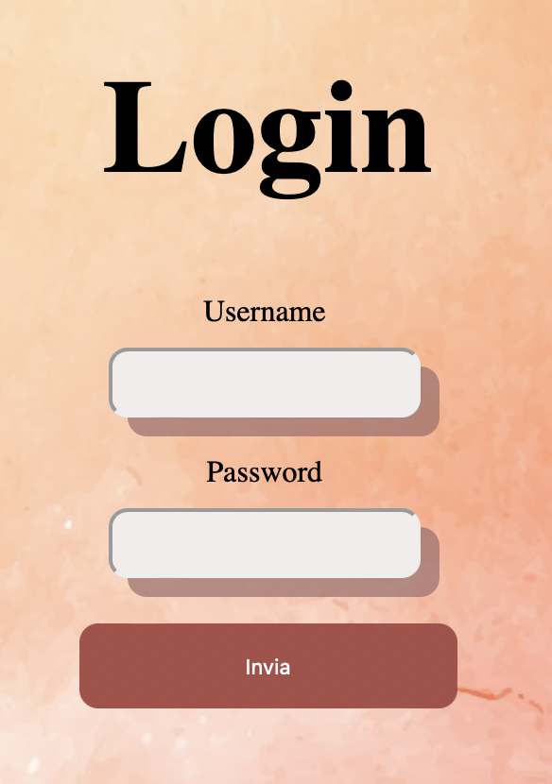
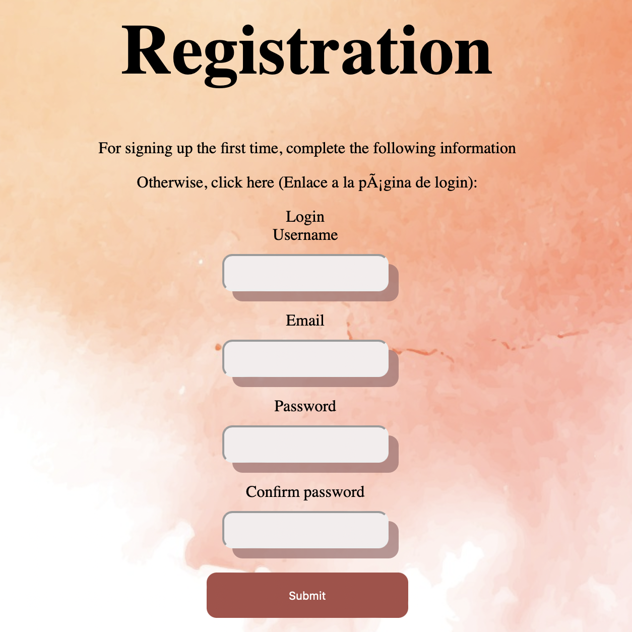
RESULT: LOGIN AND REGISTRATION

Slide 16
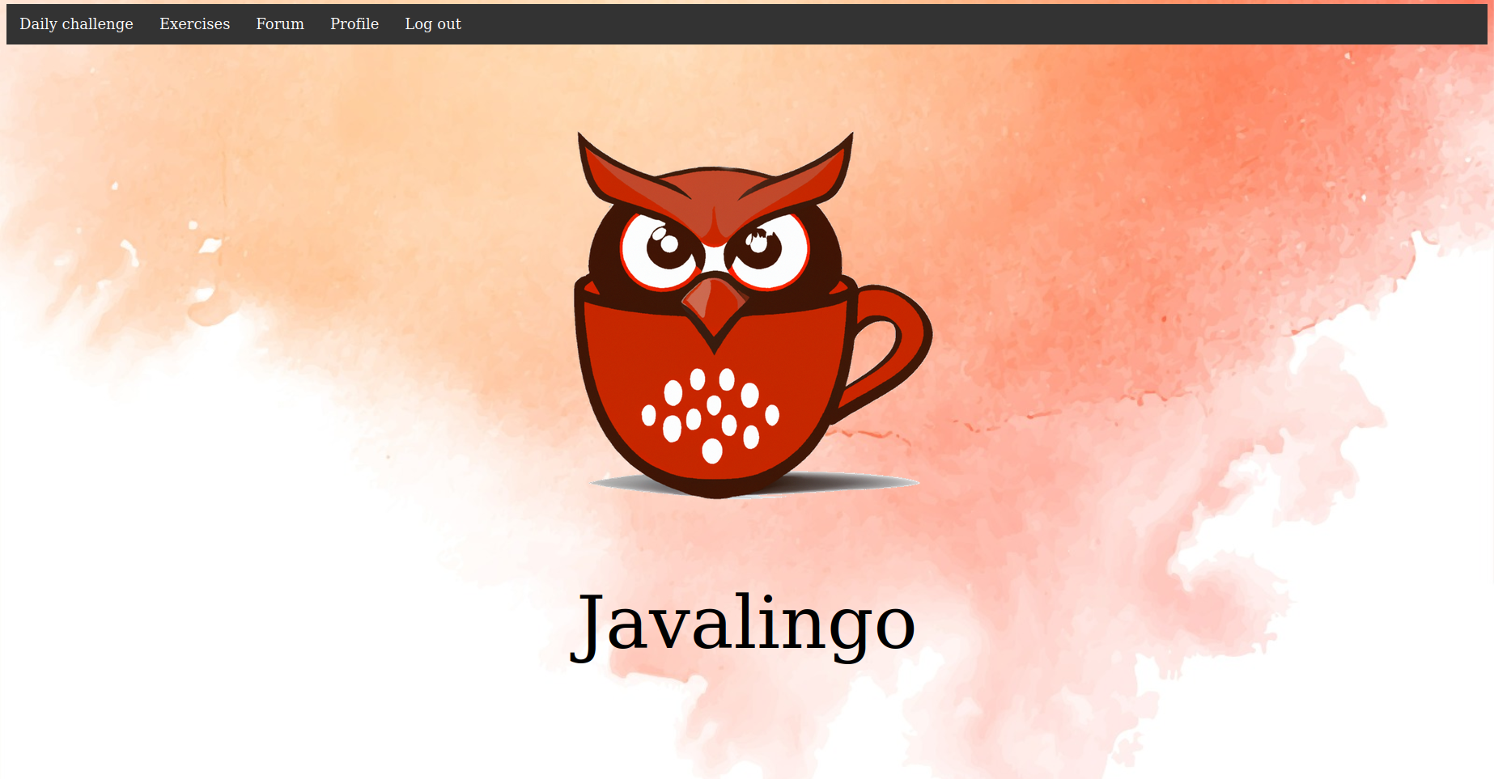
RESULT: MENU

Slide 17
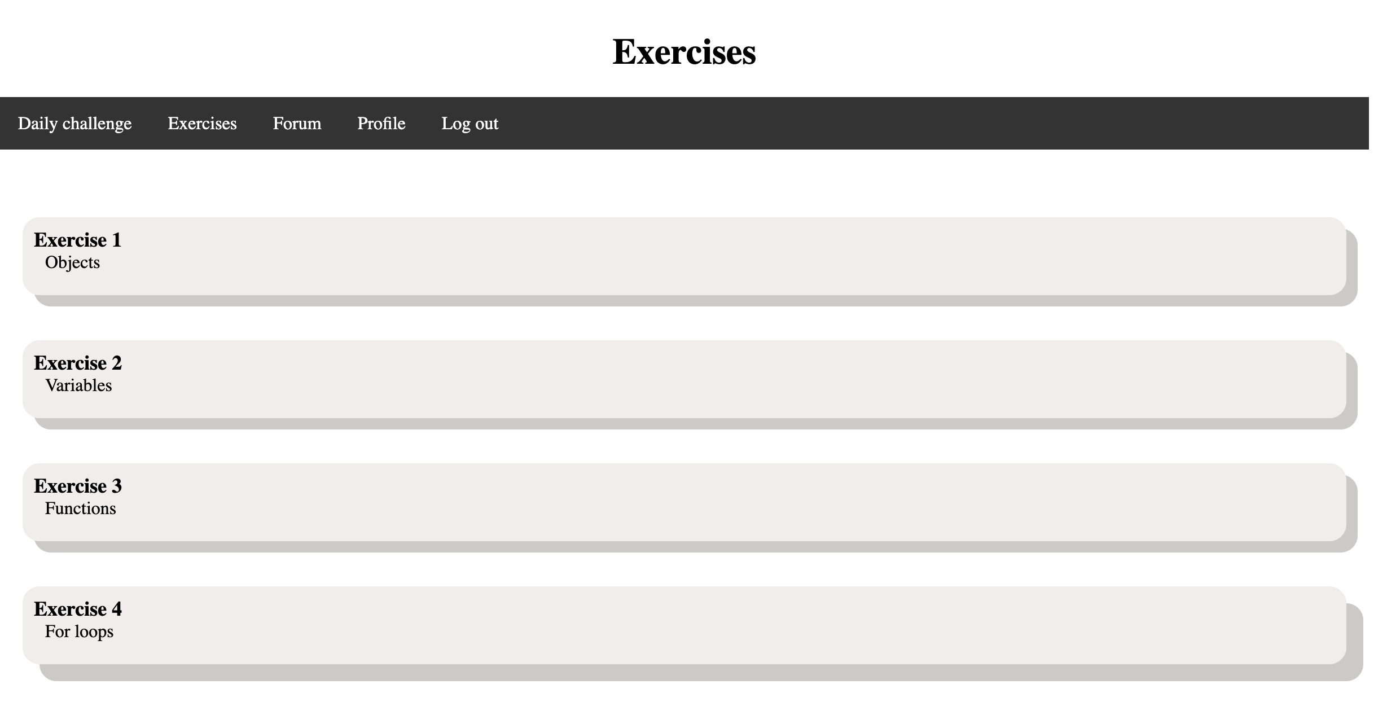
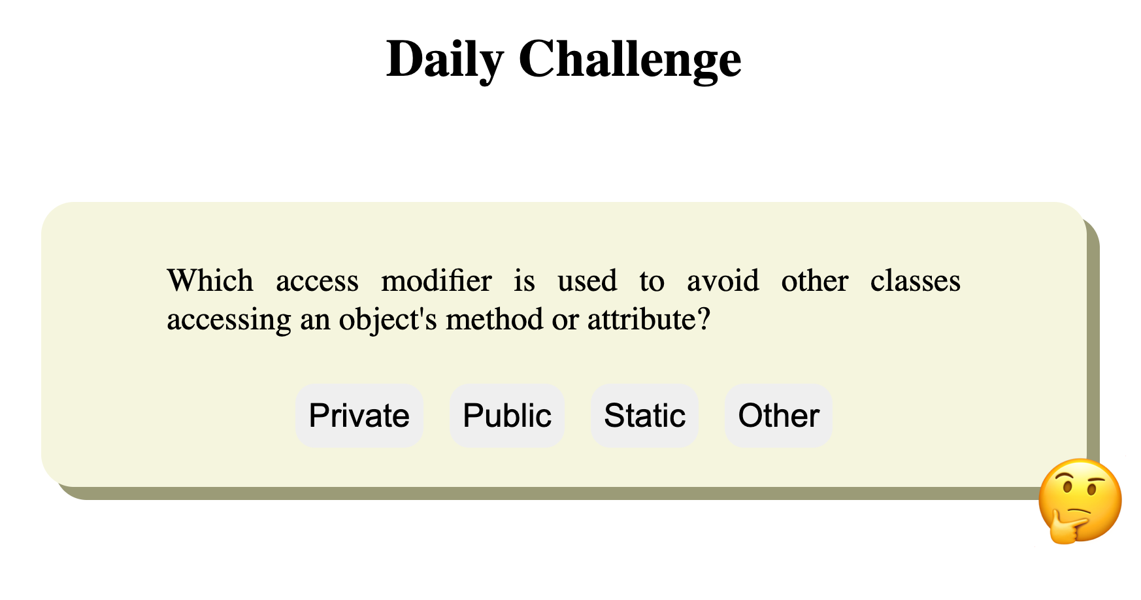
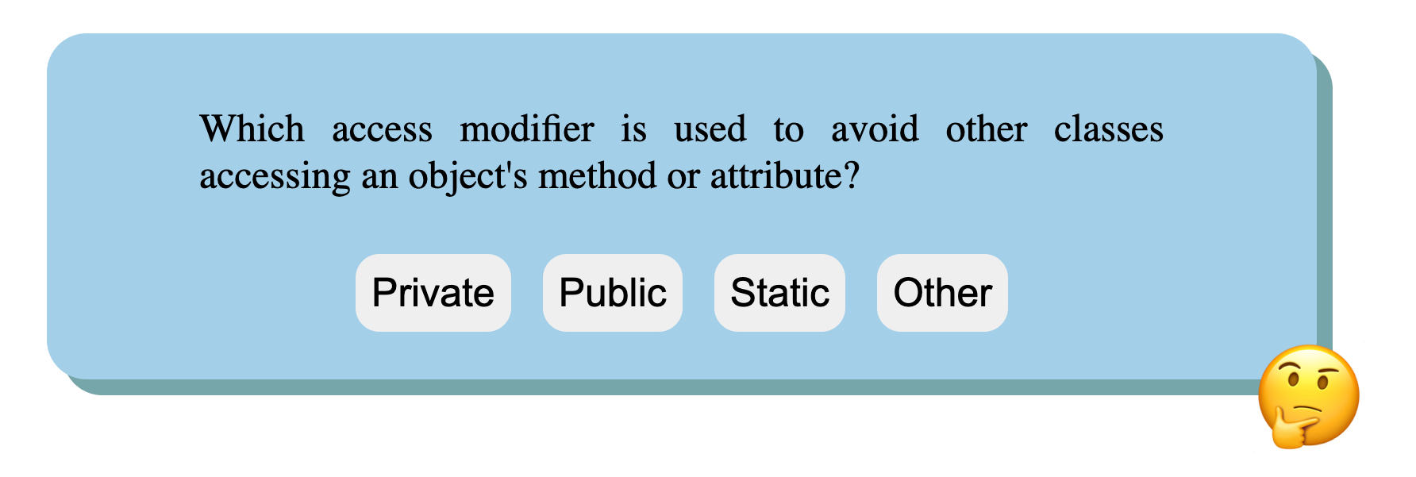
RESULT: EXERCISES AND DAILY CHALLENGE

Slide 18
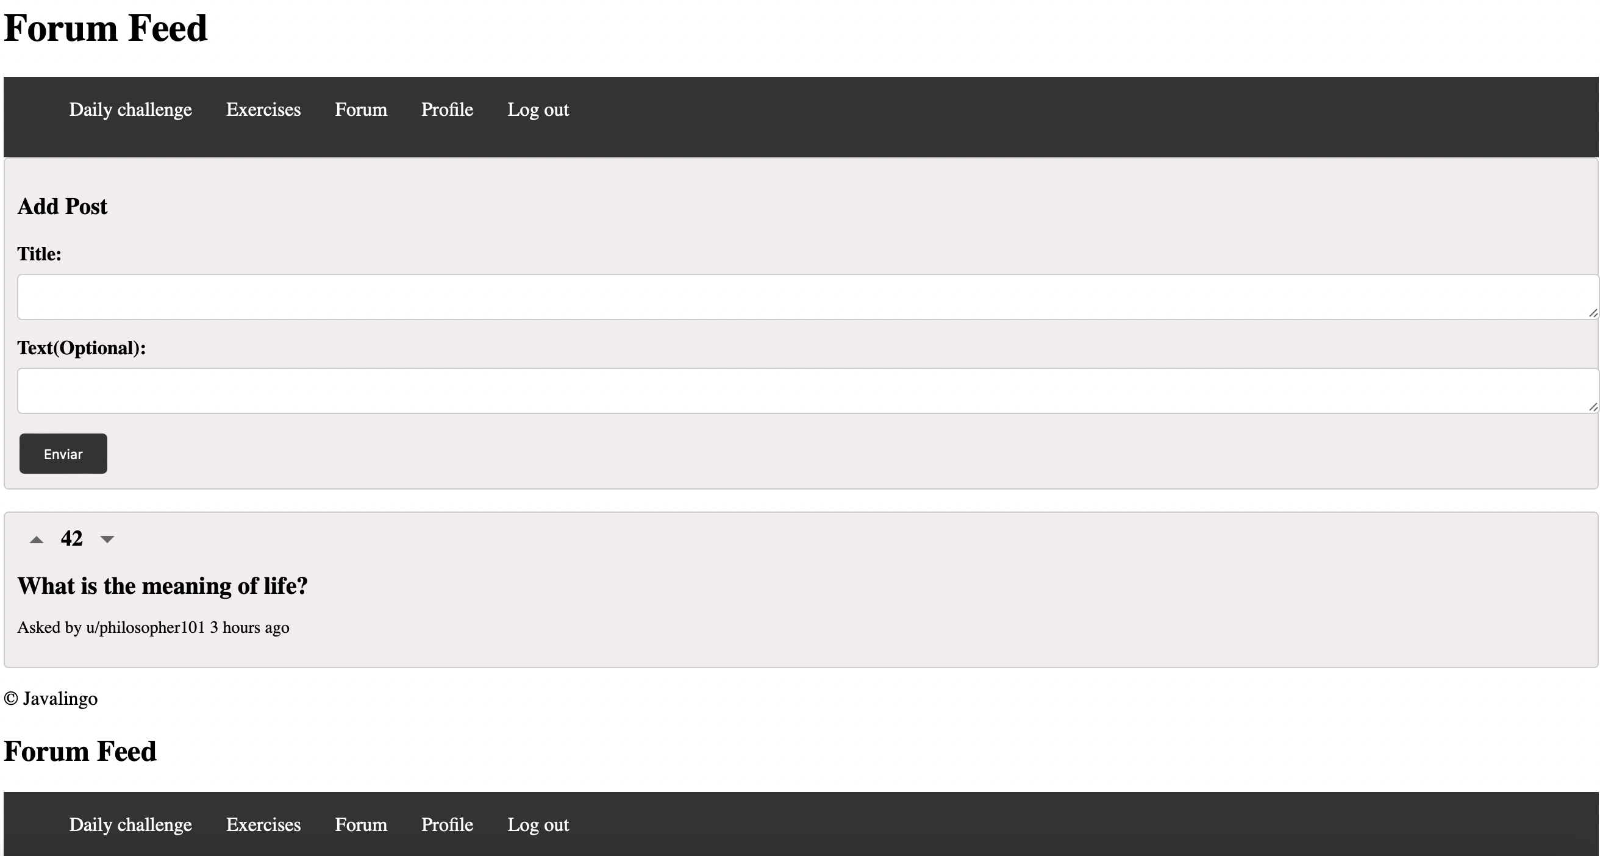
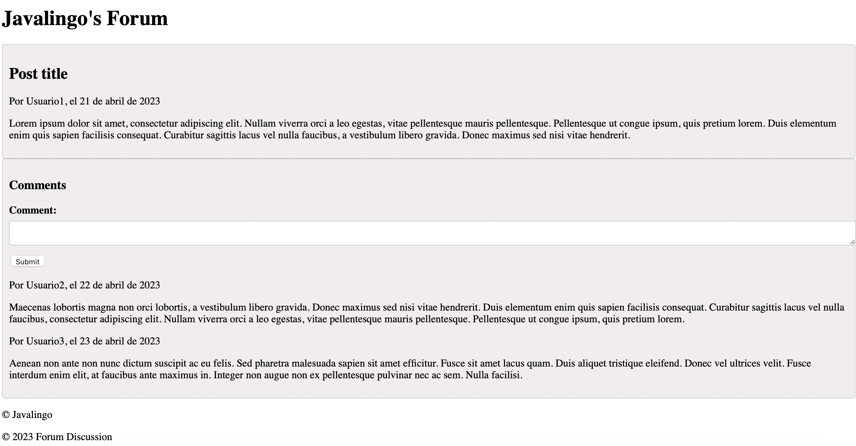
RESULT: FORUM

Slide 19

RESULT: PROFILE

Slide 20

RESULT: ADMINISTRATION PANEL
JavaLingo’s administration panel is a valuable resource for administrators, offering complete control over the application and supporting the learning experience of young programmers.
We used it for the creation and maintenance of exerceses and daily challenges

Slide 21
JAVALINGO: CONCLUSION
JavaLingo is a great resource for young programmers who want to learn the Java language in a simple way. Thanks to its innovative approach, the app simplifies the learning process, allowing users to acquire the skills necessary to become expert Java programmers, without having to depend solely on documentation.
With a variety of hands-on exercises and an easy-to-use user interface, JavaLingo makes learning the Java language engaging and effective.
In conclusion, we are sure that JavaLingo will help many young programmers to cultivate their passion.

